Slide 1
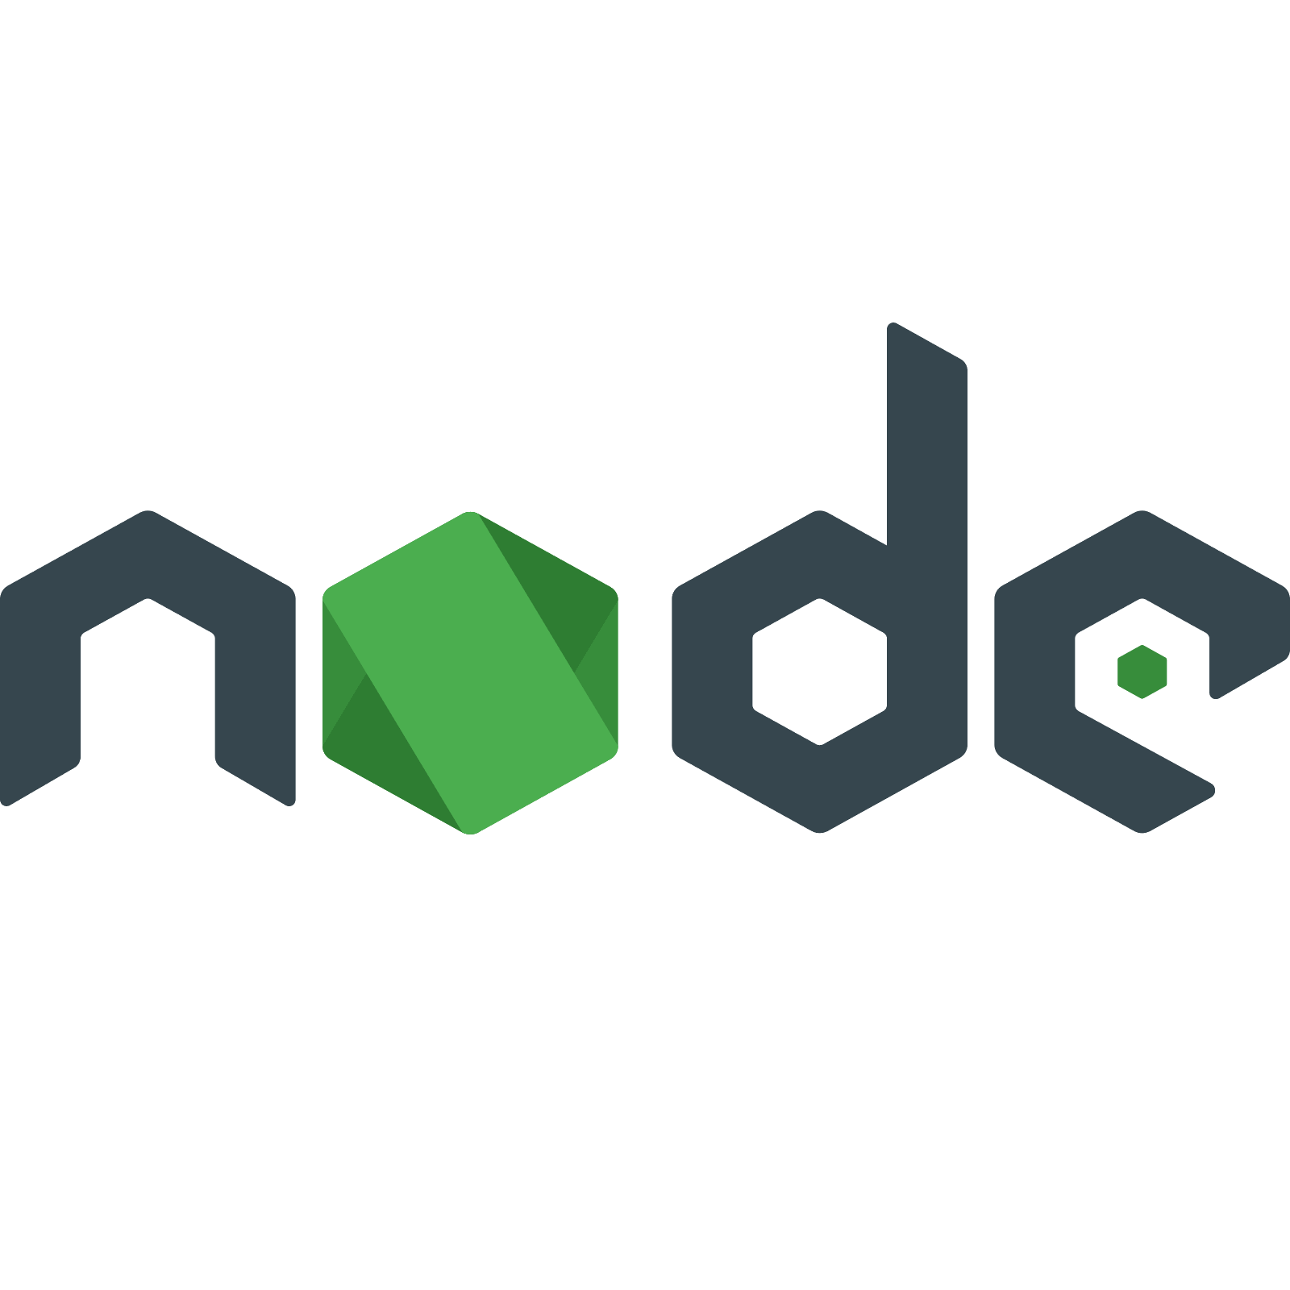
Top 10 frameworks of NodeJS
The pillars of NodeJS coding world…
Habilelabs Pvt Ltd
www.habilelabs.io

Slide 2
Objective
To have brief knowledge of NodeJS
To list down all NodeJS frameworks
To briefly know all the NodeJS frameworks
To decide which framework to select

Slide 3
NodeJS
Node.js is an open source, cross-platform server environment built on Google Chrome’s JavaScript V8 engine.
Developed by Ryan Dahl in 2009.
Used to build fast, scalable and real-time network applications.
Developers can use it to write new modules in JavaScript.
Uses asynchronous programming and does not wait for any task to complete.
Uses an event-driven, non-blocking I/O model which makes it very lightweight and efficient.

Slide 4
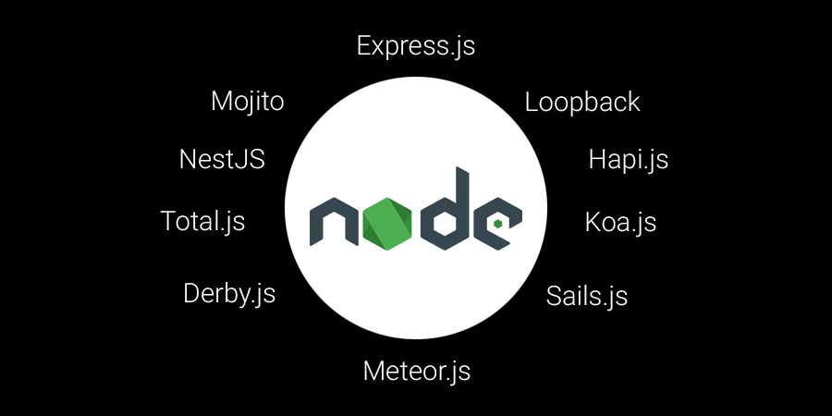
Top NodeJS frameworks – a single list

Slide 5

Express.js
Express.js is a NodeJS web application framework that gives a robust set of features for web and mobile application development.
Open source framework developed and maintained by NodeJS foundation.
It was built by TJ Holowaychuk who was one of the members of the core NodeJS team.
De facto standard server framework for NodeJS
This is the routing framework which is very lightweight and flexible.
Supports MVC(model-view-controller) architecture.
Offers template engines.
Offers multiple routing.
Building RESTful APIs is faster.

Slide 6

Loopback
It is an API framework for NodeJS that allows to build the APIs which work with any client and capable to connect various devices.
Open source framework which is highly extensible & built on top of Express.js.
Allows to create dynamic end to end REST APIs with very less coding.
Helps in creating client apps using Android, iOS, and Java SDKs.
Helps the application to run on-premises or in the cloud.
Helps in incorporating the model relationships and access controls for complex APIs.

Slide 7

Hapi.js
Independent framework of NodeJS which runs without the assistance of the Express.js.
Open source framework for web applications. Used for building web services such as JSON API.
Created by the mobile team at the Walmart LABS.
Can be used to make the HTTP proxy applications.
It is designed such that it focuses on critical project tasks instead of building infrastructure.
Provides robust plugin system that allows to add new features and fix bugs with a very fast pace.

Slide 8

Koa.js
Powerful server framework for NodeJS which is used to build magnificent web & mobile applications.
Open source framework developed by the creators of Express.js.
One of the most popular framework of NodeJS.
Completely pluggable with a huge community.
Uses generators to deal with the call backs and the error-handling.
Does not bundle any middleware within its core.
Provides unique features that make writing servers easy, fast and enjoyable.

Slide 9

Sails.js
Well known MVC (model-view-controller) framework of NodeJS.
Inspired by Ruby on Rails framework.
Allows to build REST APIs, single page apps & real-time apps quickly.
Make extensive use of code generators, which allows to build the application with less writing of code.
MVC pattern is based on Express.js and Socket.io which is absolute for writing data-oriented applications.
Provides flexibility to use any technology to develop the front-end of the application.

Slide 10

Meteor.js
Full-stack JavaScript platform for building the web and mobile apps.
Open source MVC (model-view-controller) cross-platform framework which allows to write client & server parts of an application.
Allows to develop in on language (JavaScript) in all the environments(server, browser and mobile device).
Uses data on the wire, meaning the server sends the data and not the HTML and client renders it.
Most preferably used for real-time application development, since it alone offers an ecosystem to work with without depending upon any other tool and frameworks.

Slide 11

Derby.js
Full-stack JavaScript framework which runs on top of NodeJS.
MVC(model-view-controller) JavaScript framework for client & server-side.
It has a real-time data synchronization engine and is known as Racer.
Helps applications to allow multi-site, real-time concurrency and data synchronization across client & servers.
It is written to support any database.

Slide 12

Total.js
Full-stack MVC(model-view-controller) framework used for building highly responsive web applications with HTML, CSS & JavaScript.
Offers features for performance and stability.
Compatible with client side application frameworks such as Angular, Backbone.js, React , Ember etc.
Supports Just-in-time HTML+JS+CSS compression.
Supports Just-in-time file merging.
Supports RESTful routing.
Supports video streaming, web sockets, generators etc.
No requirement of any third NodeJS modules except few database modules.

Slide 13
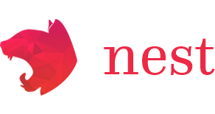
NestJS
Framework to build efficient, scalable NodeJS server side applications.
Uses progressive JavaScript built with TypeScript.
Combines elements of Object Oriented Programming (OOP), Functional Programming (FP) & Functional Reactive Programming (FRP).
It uses Express.js for its functionalities but supports many other libraries as well.
Allows easy use of third-party plugins which are available.

Slide 14

Mojito
It is JavaScript framework based on Yahoo! Cocktails which is a mobile application development platform built by Yahoo! Developer Network.
It can run on both, client side(browser) and the server side (NodeJS).
Supports MVC (model-view-controller) architecture.
Supports agile development of web applications.
It has a built in support for unit testing.

Slide 15
How to decide which NodeJS framework to choose?
Start with the type of project.
Notice the nature of the project and analyse the requirements.
Select the framework best suiting your requirements.
Check the open issues on GitHub.
Check which type of issues can be solved by the framework.
Check what is the community size of the framework.
Check what is the compatibility of the framework with other required tools.

Slide 16

Habilelabs Pvt Ltd
A premier software development company
Specialized in developing NodeJS application
Contact Us
info@habilelabs.io
www.habilelabs.io
Follow Us On LinkedIn

